Slide 1
Analysis of Inertial measurement unit with LCM software
- Kaushik Padmanabhan

Slide 2
Introduction
LCM Software:
Set of libraries and tools for message passing and data marshalling, targeted at real-time systems where high-bandwidth and low latency are critical.
Provides a publish/subscribe message passing model and an automatic marshalling/unmarshalling code generation.
Inertial Measurement Unit:
Measures and reports a body's specific force, angular rate, and magnetic field surrounding the body, using a combination of accelerometers, gyroscopes and magnetometers.

Slide 3
Objective
Isolate LCM code in its own directory.
Add device driver for IMU.
Run individual device drivers on separate machines.
Collect data with IMU and GPS puck.
Integrate IMU data to obtain displacement and compare with GPS.

Slide 4
TASKS COMPLETED
Got the utm_x (easting) and utm_y (northing) data using GPS device.
Got the yaw, pitch, roll, magnetometer, accelerometer and gyroscope values.
Logged the files and compiled the structures gps_message and imu_message and got real time statistics using lcm-spy.
Case – 1: Data collected by devices connected to one computer.
Case – 2: Data collected using networking by connecting gps device to one computer and imu device to other computer.
Case – 3: Data collected while driving the car by fixing gps and imu devices to it.
Case – 4: Correct the magnetometer yaw angle values for “Hard-Iron” and “Soft-Iron” effects.
Case – 5: Calculated ωX, found the trajectory of the vehicle and estimated xc.
TOOLS USED
The tools used are as follows.
LCM Software
Matlab

Slide 5
Process flow
Problem – 1:
Created a directory “my_robot” and transferred all the lcm, gps driver and structure files.
Problem – 2:
Created a structure imu_message including its own attributes.
Designed a device driver in python for getting the IMU data values using the imu device.
Got the GPS data values from gps device and imu data values, logged the files and got real time statistics using lcm-spy.
Problem – 3:
Ran the two devices from two different laptops connected using the network switch and got the result using the lcm-spy.
Problem – 4:
Collected the gps and imu data and populated into the MatLab using the “getvalue.m” file for various run (includes data collected when driving a car).
Problem – 5:
Corrected the measured yaw angle value for hard-iron and soft-iron effects.
Integrated the yaw rate sensor values using the filters and the file provided to get the yaw angles.
Calculated ωX, found the trajectory of the vehicle and estimated xc.

Slide 6
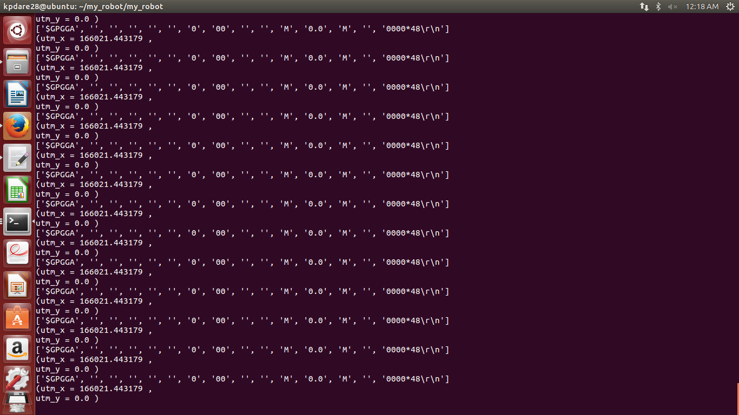
Problem – 1: GPS data from ‘my_robot” folder

Slide 7
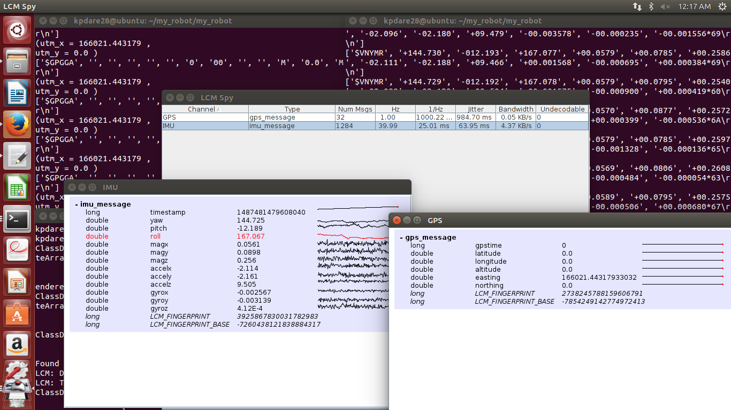
Problem – 2: gps and imu data from “My_robot” folder

Slide 8
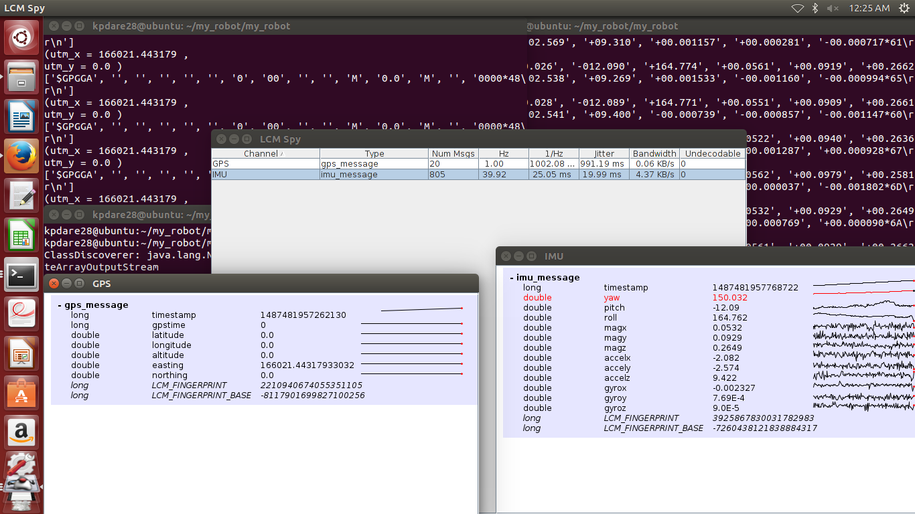
Problem – 3: getting gps and imu data without internet

Slide 9
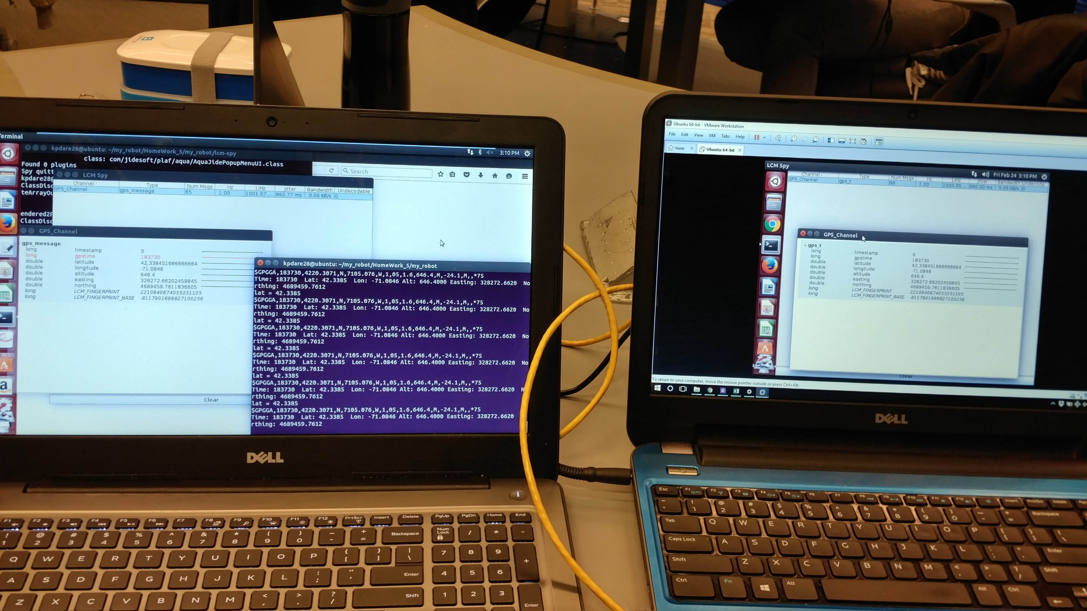
Two laptops connected via lan

Slide 10
(CONTD.)
The gps device and the imu device are connected to one laptop and ran lcm-spy in another laptop.
Process Flow:
Connected the Ethernet cable between two laptops.
Assigned a static ip address to both the computers (192.168.10.1 and 192.168.10.2).
Checked whether the two laptops pinged each other. Then used following two commands to make the data to multicast.
→ sudo ifconfig eth0 multicast
→ sudo route add -net 224.0.0.0 netmask 240.0.0.0 dev eth0
Then, set the TTL to 1 so that the data can be transmitted over the wire.
Ran the run file in one laptop and recorded the data from lcm-spy in other laptop.

Slide 11
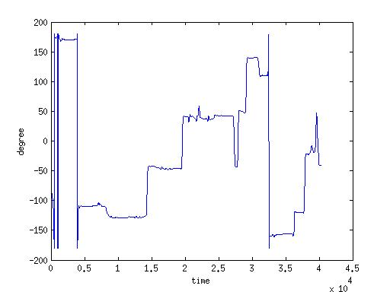
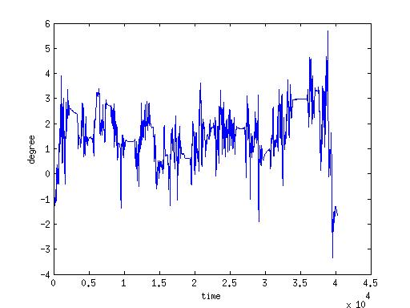
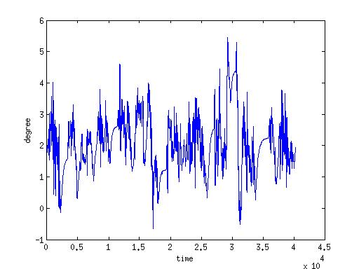
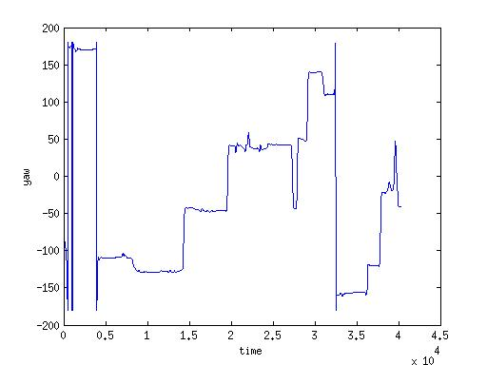


Problem – 4: Collected imu and gps data : yaw, roll, pitch

Slide 12
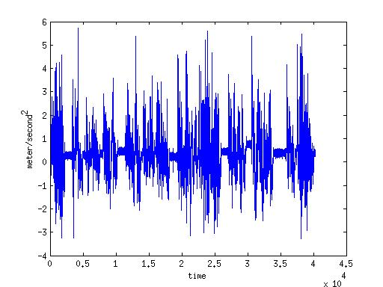

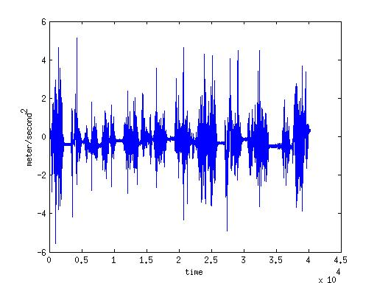
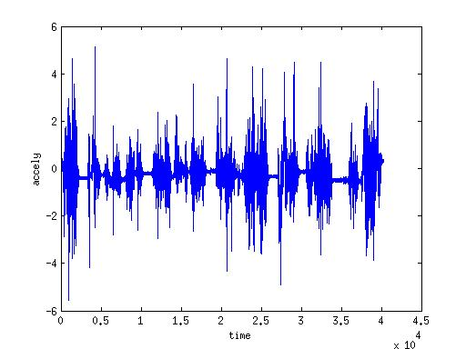
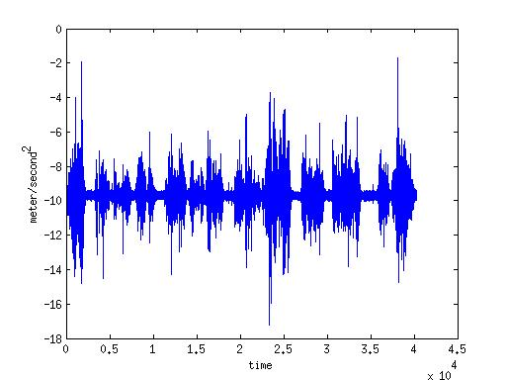

(Contd.) : 3 – accelerometer plot

Slide 13
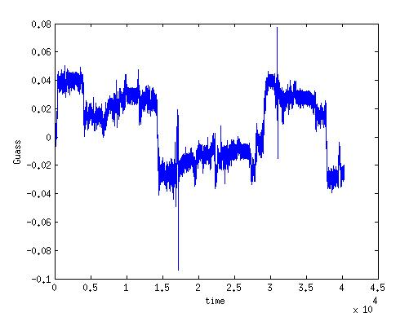

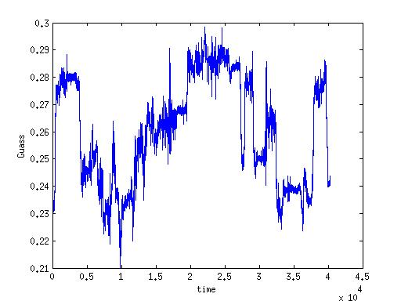

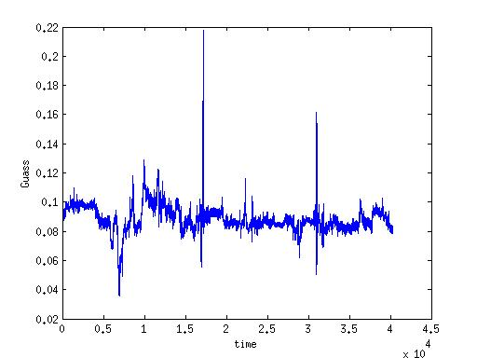

(Contd.) : 3 – magnetometer plot

Slide 14
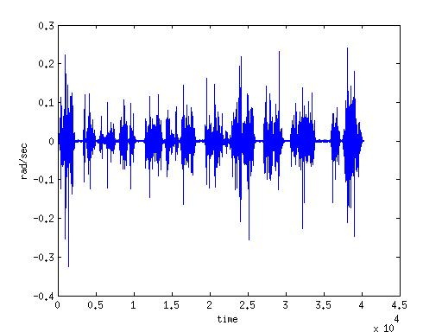

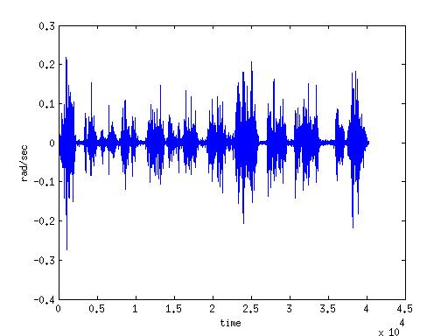

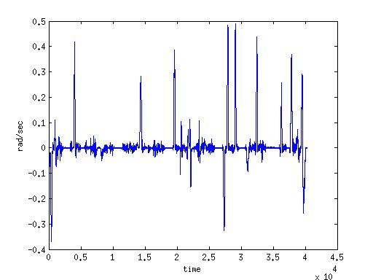

(Contd.) : 3 – gyroscope plot

Slide 15
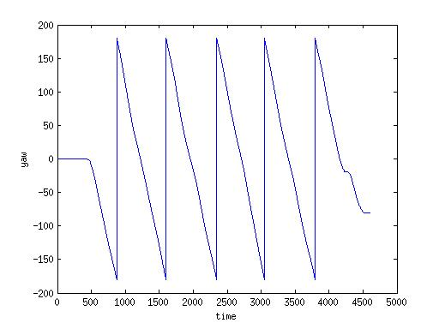
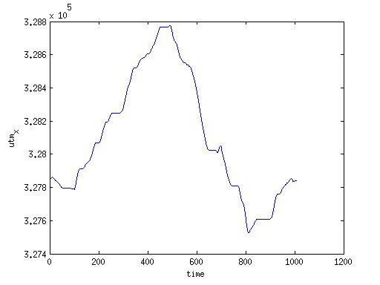
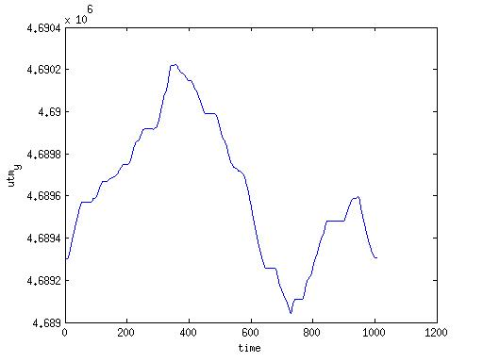
(Contd.) : 3 – yaw (circular), utm_x and utm_y

Slide 16
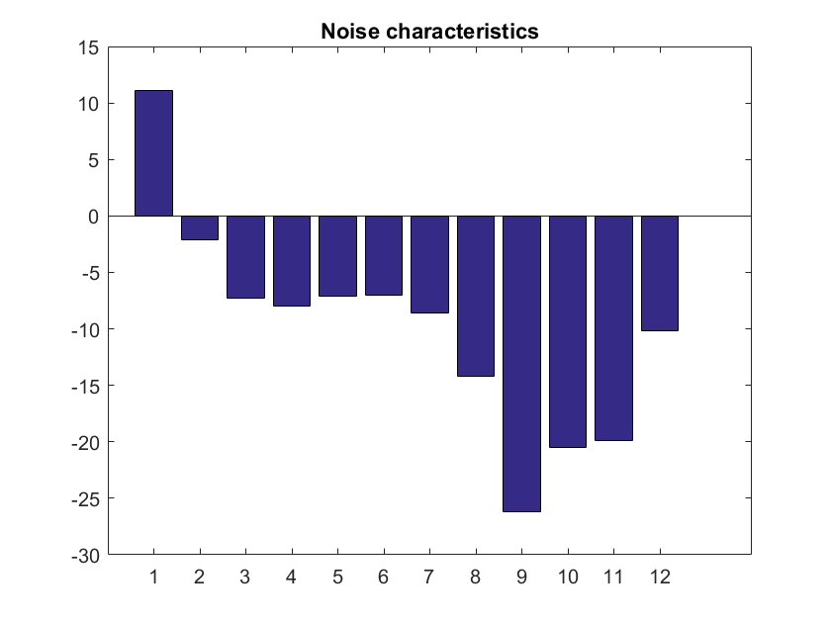
Noise characteristics
yaw
pitch
roll
accelx
accely
accelz
magx
magy
magz
gyrox
gyroy
gyroz

Slide 17
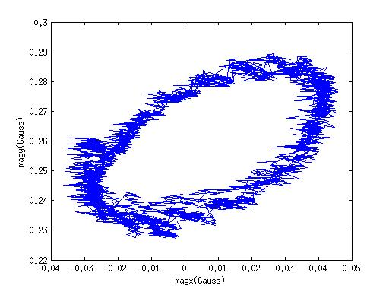
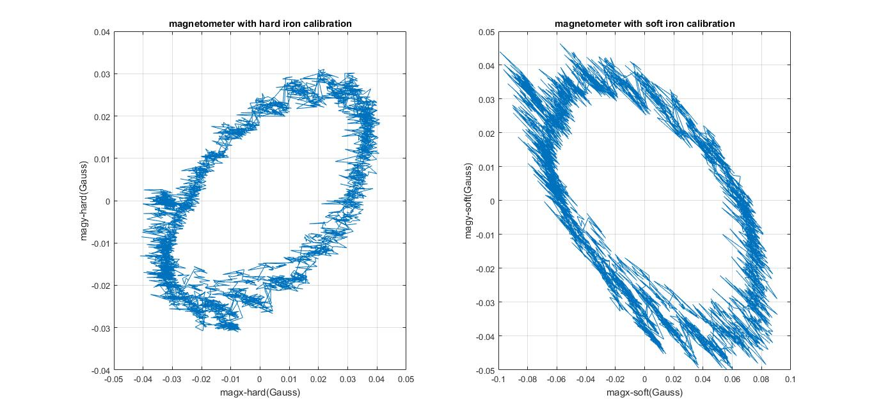
Hard IRON AND SOFT iron calibration

Slide 18
HARD IRON AND SOFT IRON EFFECTS
Process Flow:
The obtained magnetometer values (magx and magy) are plotted against eachother and a ellipse is obtained.
These values are then averaged and subtracted from their average to obtain the improved magnetometer values, which when plotted makes the ellipse to center at (0,0).
After the hard iron effects, the obtained magnetometer values will then be squared and added within the square root and a new value will be obtained, from which the “sigma” and ‘’theta” will be obtained.
After getting the sigma and theta value, a rotation and a re-rotation matrix is formed which will ultimately produce the required magx and magy value.
Analysis:
The magnetometer readings are corrected for hard iron and soft iron effects.
By correcting hard iron effects, the elliptical plot will center at (0,0).
By correcting soft iron effects, the elliptical plot will slightly change to circular plot.

Slide 19
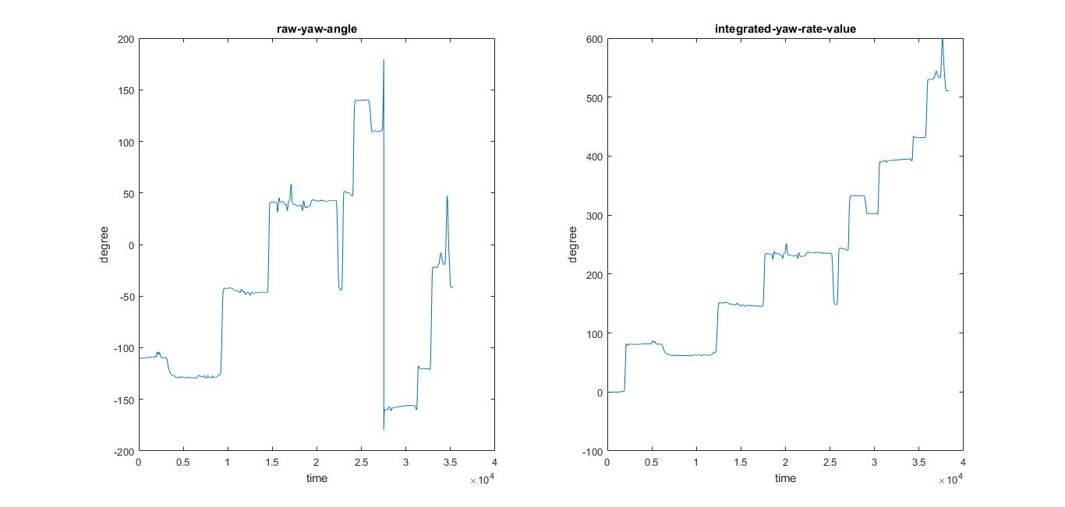
RAW YAW ANGLE VS INTEGRATED YAW-RATE-SENSOR VALUE

Slide 20
(contd.)
Process Flow:
Got gyroscope (gyroz) values and converted the unit of gyroz from radian per second to degrees per second.
Integrated the converted gyroscope values and found the new yaw angle values.
Analysis:
From the comparison between the raw yaw value and the integrated yaw rate sensor values, the plot obtained by the latter is more or less same as the former with a hike in between in the latter.

Slide 21
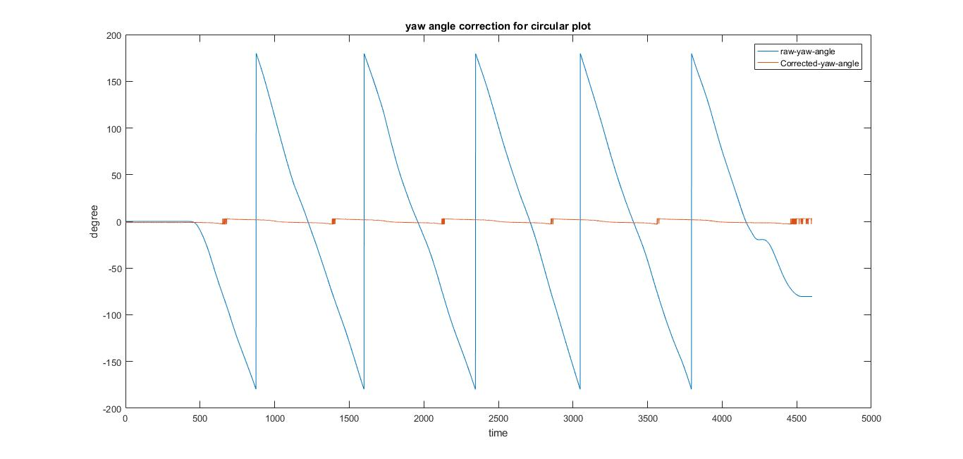
RAW YAW ANGLE VS MAGNETOMETER CORRECTED YAW ANGLE FOR CIRCLE

Slide 22
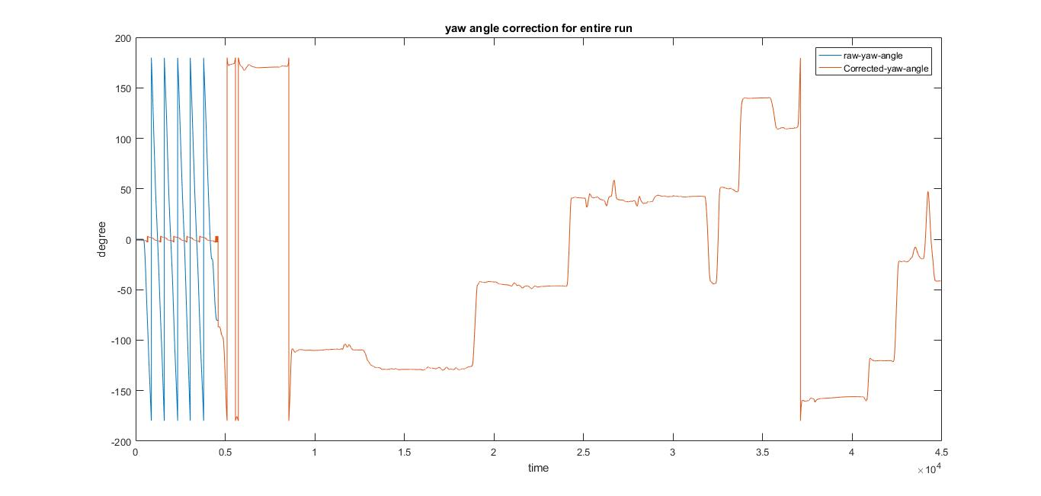
RAW YAW ANGLE VS MAGNETOMETER CORRECTED YAW ANGLE FOR ENTIRE RUN

Slide 23
YAW CALUES CALCULATED FROM CORRECTED MAGNETOMETER
The yaw angle values are then calculated from the corrected magnetometer values.
In both the figures (first figure is for circle and the second figure is for the entire run), the yaw angle value calculated after the corrected magnetometer readings has showed a change (reduced spikes) from the raw yaw angle values, at the initial parts (1 to 5000), where the car took a circle while driving.

Slide 24
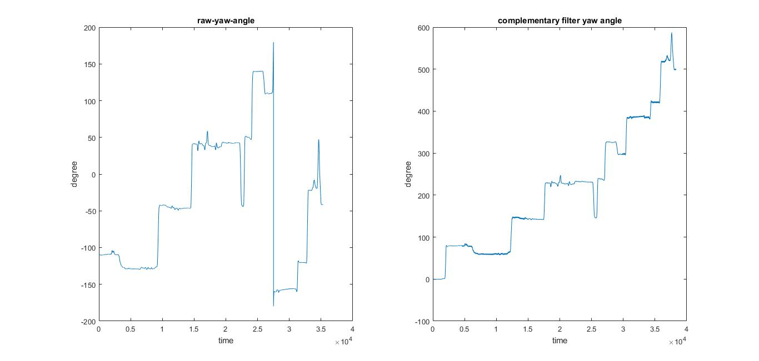
RAW YAW ANGLE VS COMPLEMENTARY FILTER YAW ANGLE

Slide 25
(Contd.)
Process Flow:
Got the integrated gyroscope values and the corrected magnetometer yaw angle values.
By adding 0.98 times the integrated yaw rate value and 0.02 times the corrected magnetometer yaw value, the complementary filter yaw values are obtained.
Analysis:
From the comparison between the raw yaw value and the complementary filter yaw values, the plot obtained by the latter is more or less same as the former with a hike in between in the latter. It is also similar to the plot obtained by the integrated yaw rate value
Analysis:

Slide 26
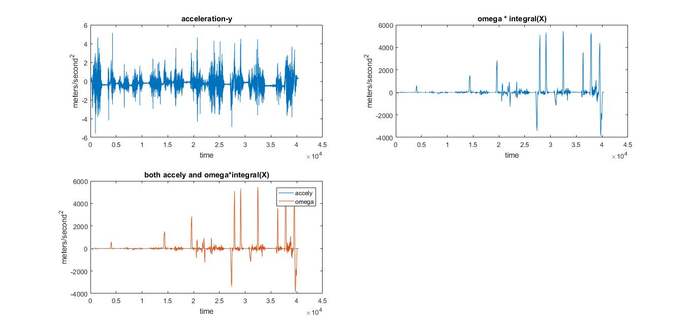
Comparison of observed accel-y and omega * Integral(X)

Slide 27
(Contd.)
Process Flow:
Integrated the obtained accelx values and multiplied with the gyroz values.
Analysis:
The obtained product is then plotted and the plot is compared with the accely.
From the comparison, it is noted that the plot obtained from the accely is smaller compared to the product value and more spikes are reduced in the product value when compared to the accely value.

Slide 28
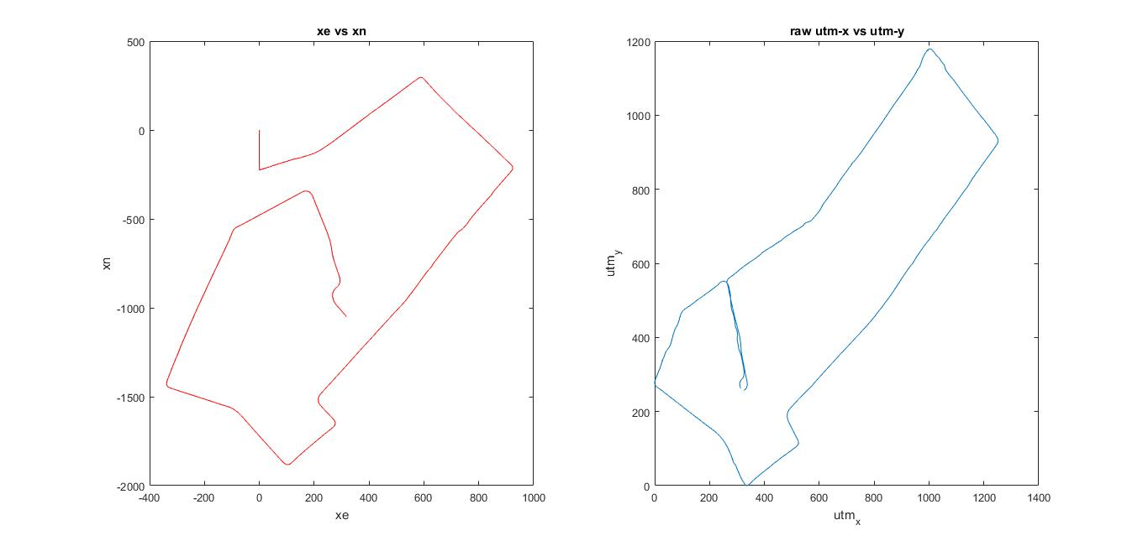
Estimate of trajectory of the vehicle

Slide 29
(Contd.)
Process Flow:
New acceleration values are got by subtracting the old values from the pitch angle using cosine in degree function.
By integrating the acceleration values obtained, the velocity is calculated.
From the general velocity obtained, the velocity experienced in North and East sides are calculated.
Then, displacement is calculated by integrating those velocities.
By plotting the displacements obtained, the trajectory took by the car is obtained.
Analysis:
A plot between data values (utm_x and utm_y) obtained from the gps device is compared with the plot between the obtained displacement values Xe and Xn which are obtained by integrating the data values got from imu device.
From the plot comparison, the trajectory took by the car, got by integrating the imu data values is similar to the trajectory took by the car. (for gps the trajectory joined which was not our route)

Slide 30
CONCLUSION
Thus IMU and GPS values are made to interact with the LCM software and the values are logged and plotted, along with the calibration of yaw angle for hard and soft iron effects.

Slide 31
